Slide 1
Car Price Prediction Model
Submitted By:
Name-Ajit Roll Number-200616

Slide 2
Problem Statement
A Chinese automobile company Geely Auto aspires to enter the US market by setting up their manufacturing unit there and producing cars locally to give competition to their US and European counterparts.

Slide 3
They want to understand the factors affecting the pricing of cars in the American market, since those may be very different from the Chinese market. The company wants to know:
-Which variables are significant in predicting the price of a car
-How well those variables describe the price of a car
-Based on various market surveys, the consulting firm has gathered a large data set of different types of cars across the America market.

Slide 4
Goal
We are required to make and deploy a model to help management to understant how exactly the prices vary with the independent variables so that it can accordingly manipulate the design of the cars, business stratergy etc to compete in market.

Slide 5
Steps Take Under Project
Data Cleaning And Data Preparation
EDA(Exploratory Data Analysis)
Feature Selection Using Recursive Feature Elimination(RFE)
Data Modelling And Evaluation.
Deploying The Best Model.

Slide 6
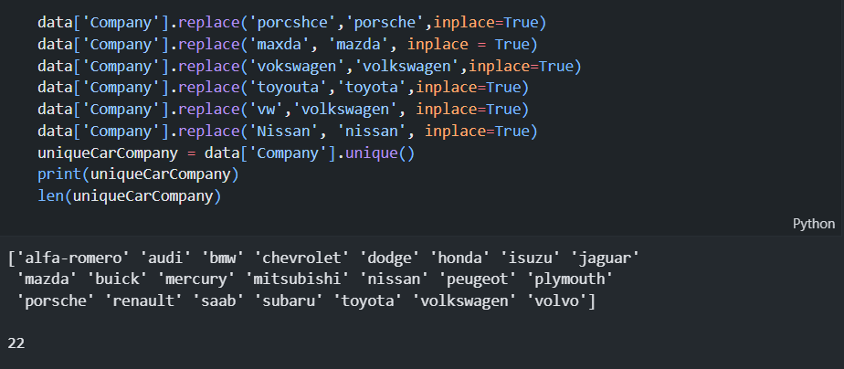
Step 1:Data Cleaning And Data Preparation
Duplicate names were handled
- Wrong names were replaced by correct name

Slide 7
EDA(Exploratory Data Analysis)
Done to get relationship between price of car and it’s dependency on various car features.
Done to get insight into the data.
All the outcomes are shared in bullet points in JupyterBook.

Slide 8
Feature Selection
Feature selection methods are intended to reduce the number of input variables to those that are believed to be most useful to a model in order to predict the target variable.
15 Features are extracted for modellling using Recursive Feature Elimination

Slide 9
Data Modelling
We have used sklearnl module’s library for modelling and used linear regression, decision tree and random forest regressor.
Random forest gave us the highest accuracy.
We saved the model using pickle libraby.

Slide 10
Deployment
The saved model is deployed using Flask with simple user interface.

Slide 11
Thankyou

